Slide 1
PREDICTIVE PERFORMANCE MANAGEMENT
Capstone Project 2024
Stanley Kelman Jr.
December 16, 2024

Slide 2
PREDICTIVE PERFORMANCE MANAGEMENT OBJECTIVES
Employee Turnover Prediction
Analyze historical data: attendance, performance metrics, feedback scores, tenure.
Key Indicators:
Declining performance metrics.
Increased absenteeism or sick days.
Reduced engagement in activities. Outcome: Identify at-risk employees and deploy retention strategies.
Disengagement Detection
Detect subtle signs of disengagement using:
Reduced participation in daily meetings.
Delays in task completion.
Sentiment analysis in communication. Outcome: Re-engage employees through recognition, mentoring, and workload adjustments.
Proactive Intervention
Use predictive insights to:
Tailor development plans.
Adjust work conditions to prevent burnout.
Offer targeted incentives to top performers. Examples:
Balance workloads to prevent fatigue.
Address fairness in roles/compensation.
Strategic Workforce Planning
Forecast future turnover trends to plan ahead.
Identify at-risk roles and departments.
Develop strategies to address attrition risks.
Understand why certain areas face turnover. Outcome: Better recruitment, retention, and
workforce optimization.

Slide 3
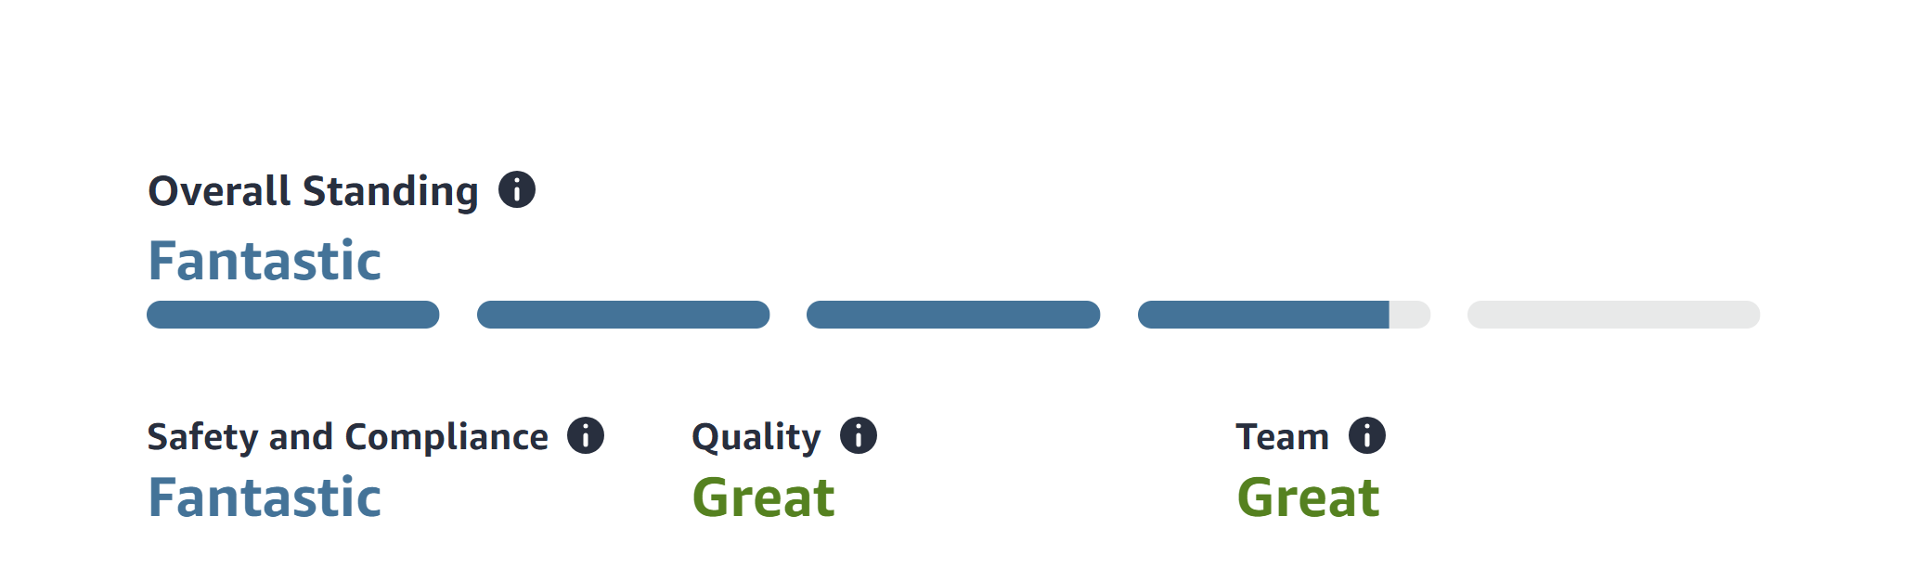
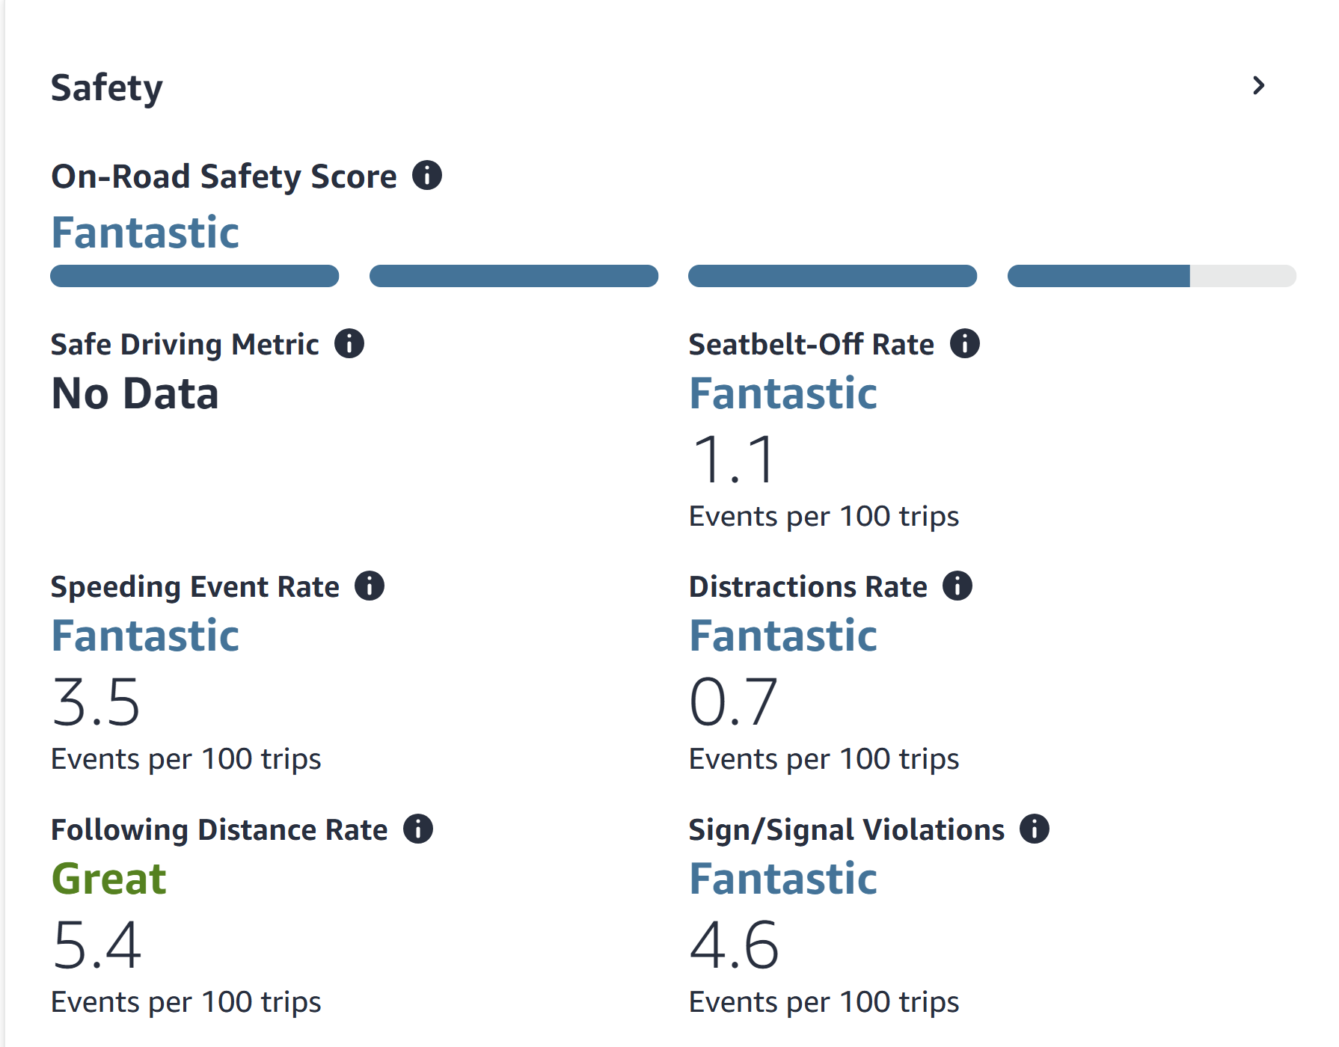
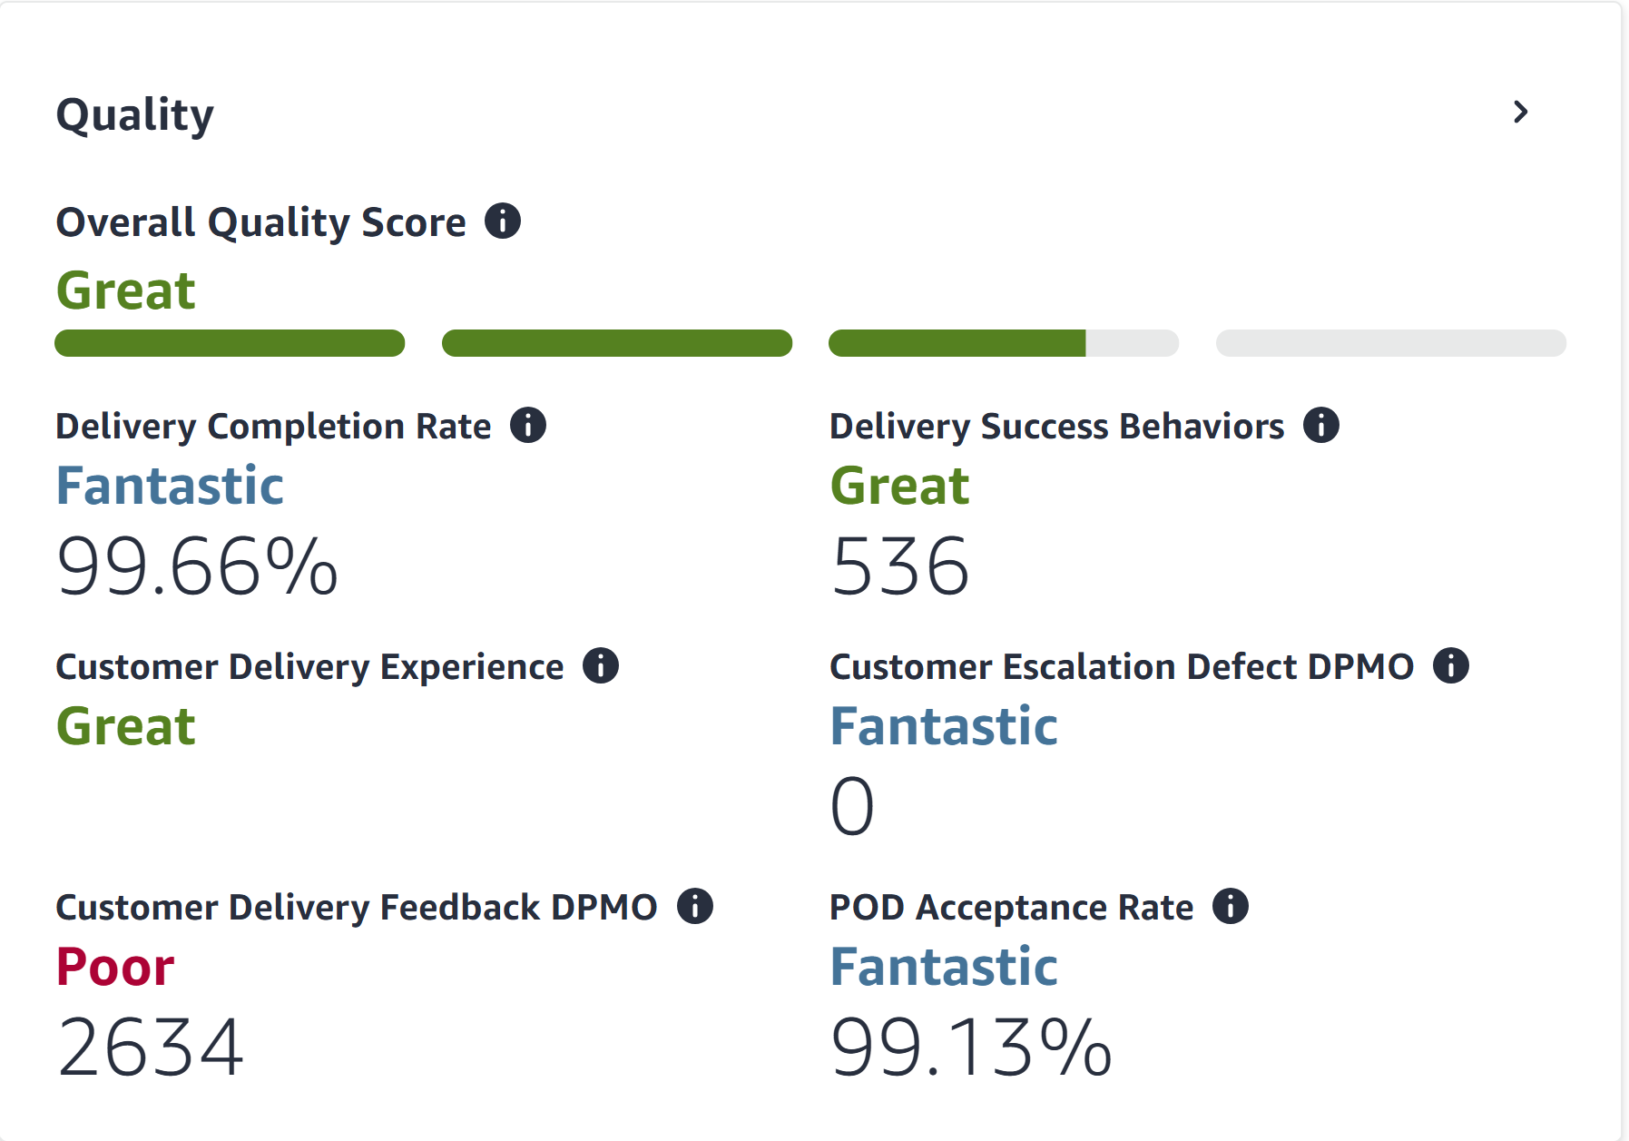
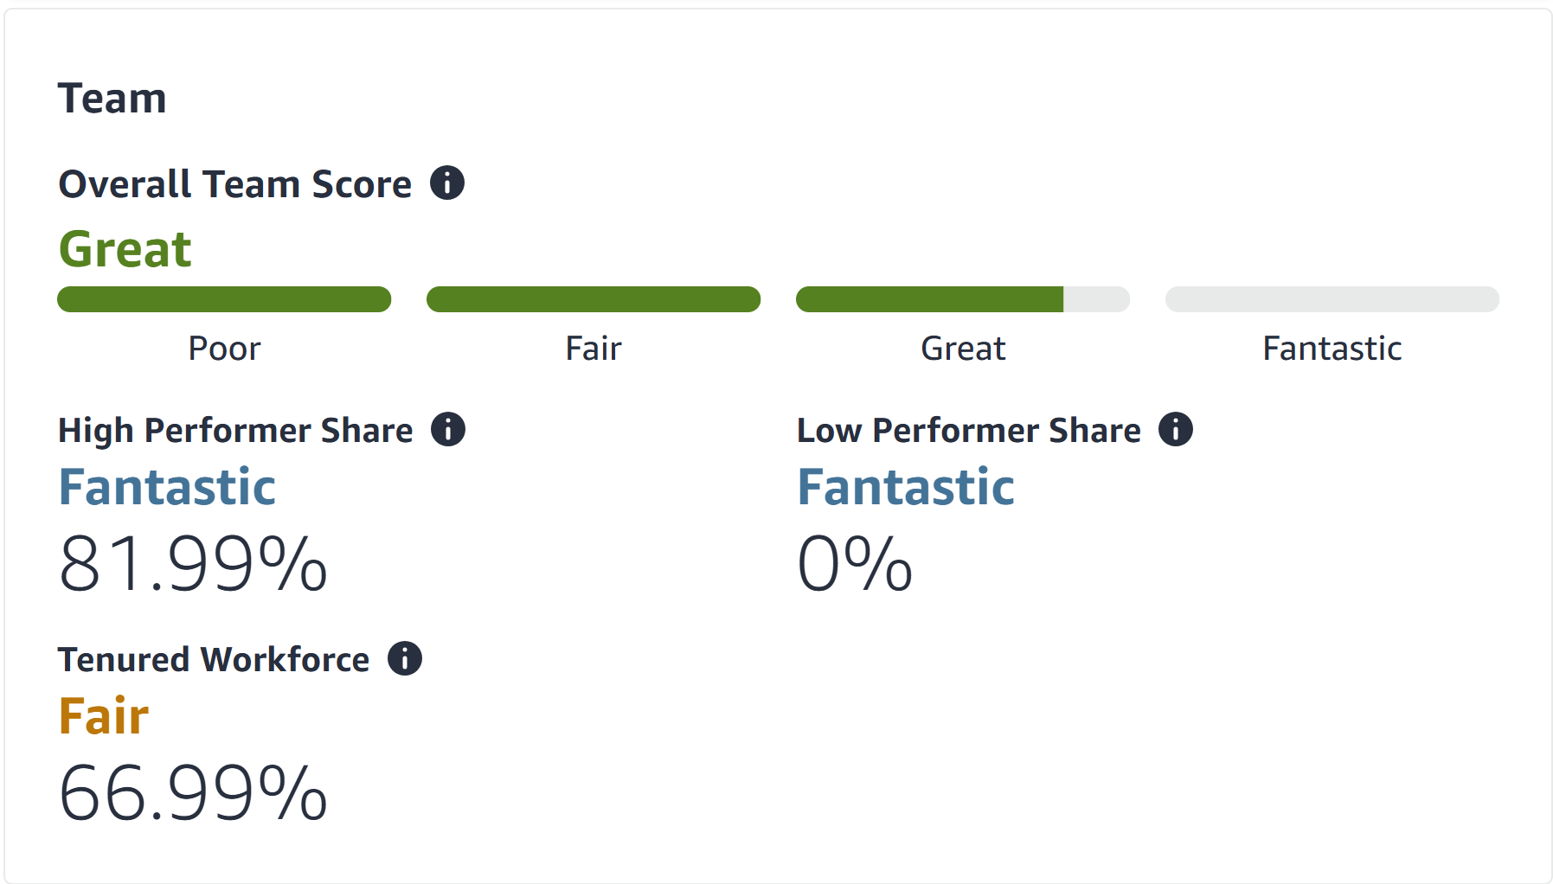

Team Overall Weekly Scorecard

Slide 4
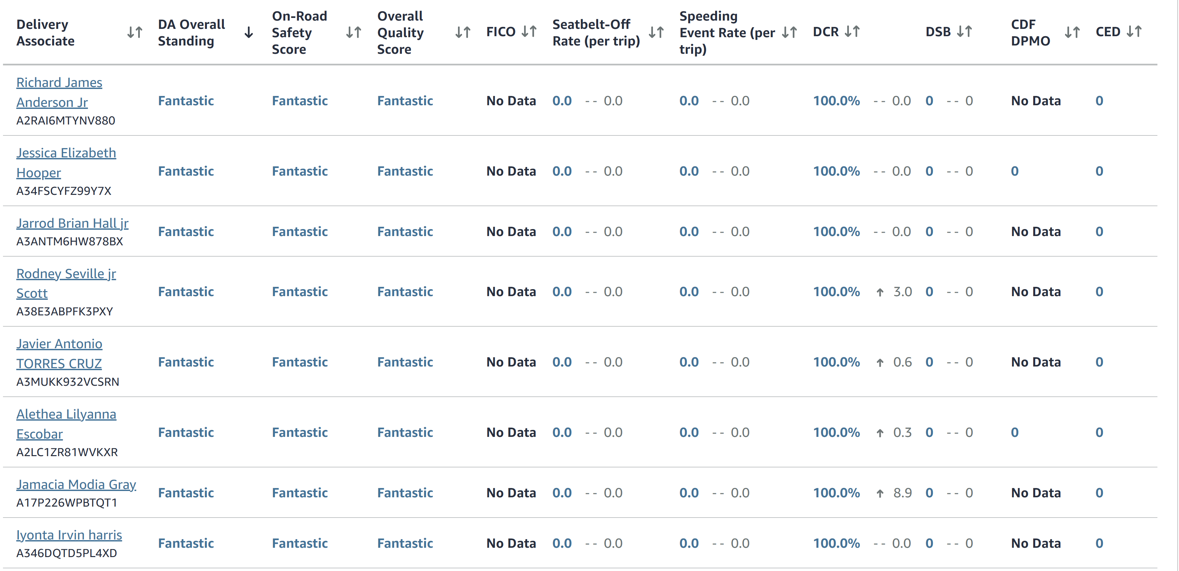
Individual Employee Overall Weekly Scorecard

Slide 5
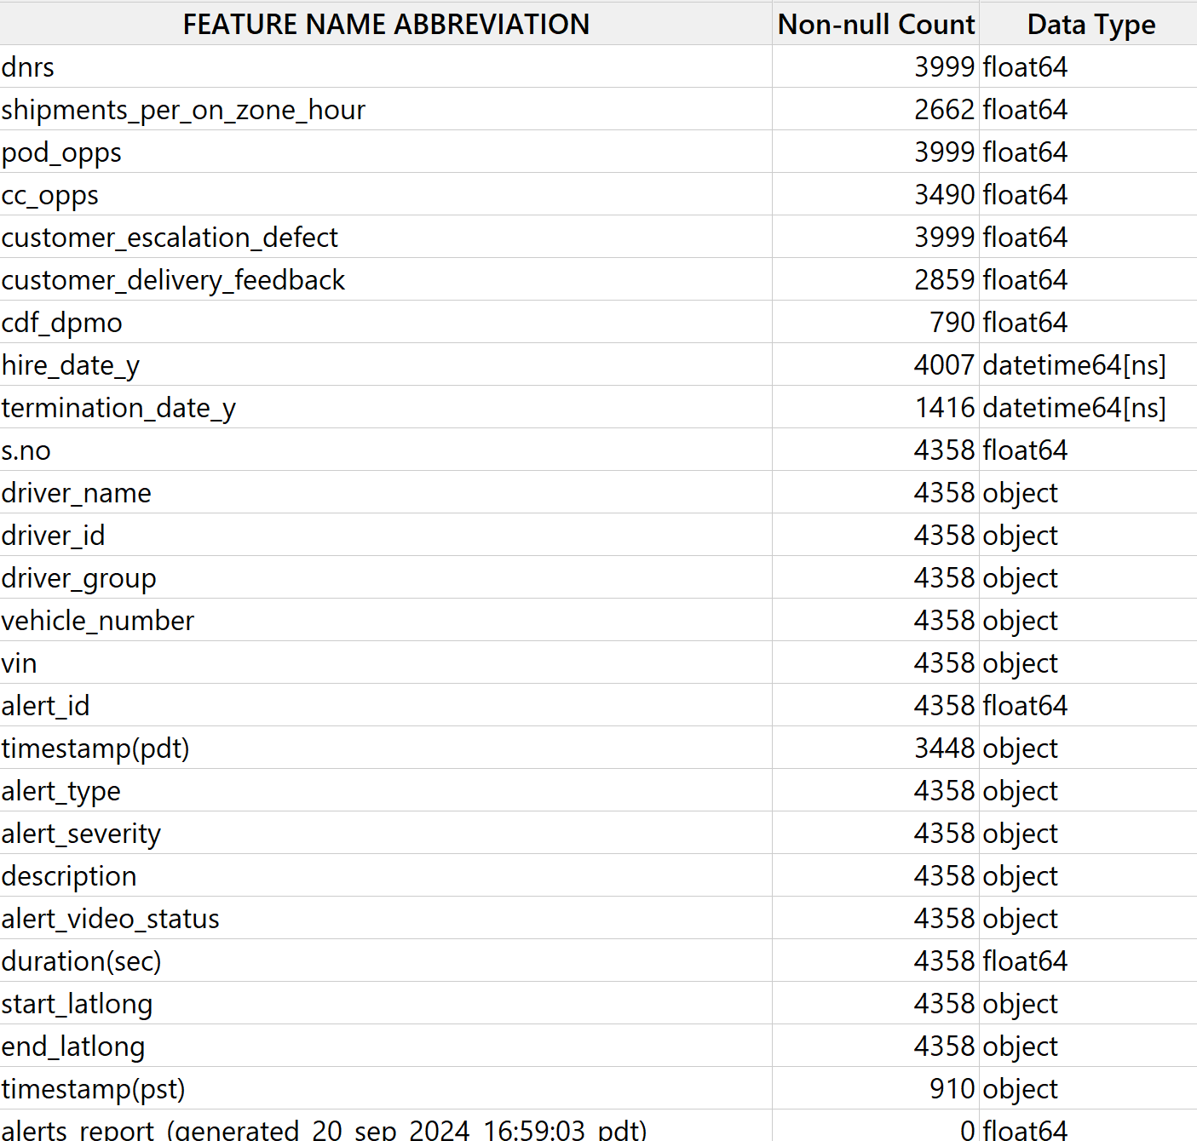
Scorecard Feature Labels

Slide 6
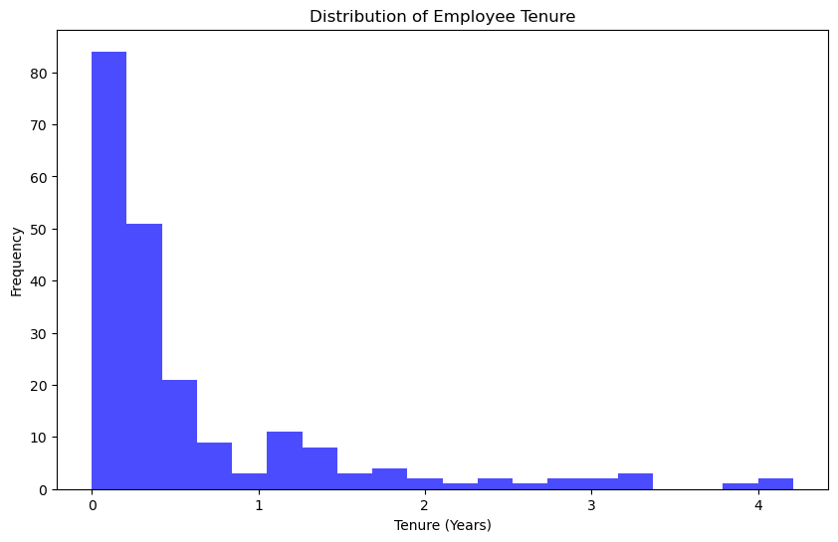
Interpretation of the Distribution of Employee Tenure
Skewed Distribution:
The histogram shows a right-skewed distribution, where the majority of employees have very low tenure.
A significant portion of employees have a tenure of less than 1 year.
High Turnover Rate:
The large frequency at the lower end (close to 0 years) suggests that many employees leave within a few months.
This indicates potential issues such as high turnover, onboarding challenges, or a lack of long-term retention.
Gradual Decline in Frequency:
As tenure increases beyond 1 year, the number of employees significantly decreases, indicating that fewer employees remain for long durations.
The decline becomes more gradual as tenure approaches 2 to 4 years.
Small Long-Tenured Group:
There are very few employees with tenure exceeding 3 years, suggesting retention of long-term employees is low.
Key Takeaways:
Focus on Retention: Investigate why turnover is high within the first year and address root causes (e.g., training, work conditions, career progression).
Retention Programs: Implement targeted strategies to retain employees beyond the critical early months.
Analyze Cohorts: Explore whether certain roles or departments have higher turnover rates than others.
This distribution strongly signals a need to prioritize employee engagement and retention efforts.

Slide 7
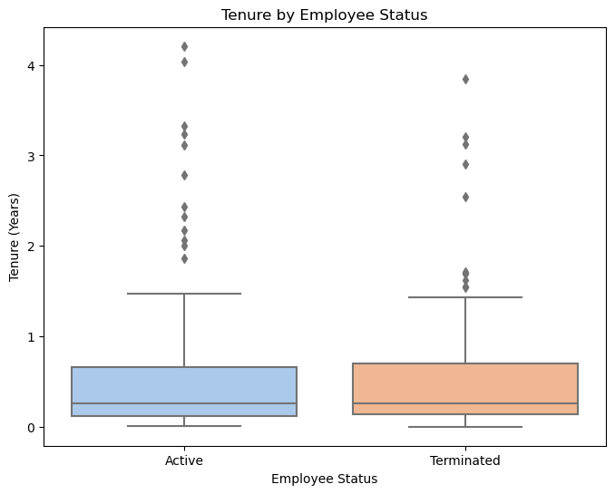
Interpretation of Tenure by Employee Status
Similar Median Tenure:
Both Active and Terminated employees have a similar median tenure (around 0.5 years), which suggests that employees, whether active or terminated, typically do not stay for long.
Interquartile Range (IQR):
The IQR for both groups is narrow and concentrated below 1 year, meaning most employees (active or terminated) leave or remain in their roles within a short timeframe.
Outliers:
There are several outliers with tenure exceeding 2 to 4 years in both groups.
This indicates a small number of long-tenured employees, but these cases are exceptions rather than the norm.
Slightly Higher Spread for Active Employees:
The spread (maximum whisker length) for Active employees appears slightly broader, which could indicate that a few active employees have managed to stay in their roles for a longer time compared to terminated employees.
Turnover Trends:
The presence of similar patterns for both groups suggests that employee turnover might not be improving over time.
Short tenure across both statuses could reflect challenges like onboarding issues, work dissatisfaction, or mismatched role expectations.
Key Insights:
Retention Focus: High turnover within the first year needs urgent attention.
Outlier Analysis: Examine long-tenured employees to understand what keeps them engaged and replicate these strategies.
Turnover Risk: Employees leaving early are consistent across both groups, emphasizing a need for intervention in onboarding and employee engagement.

Slide 8
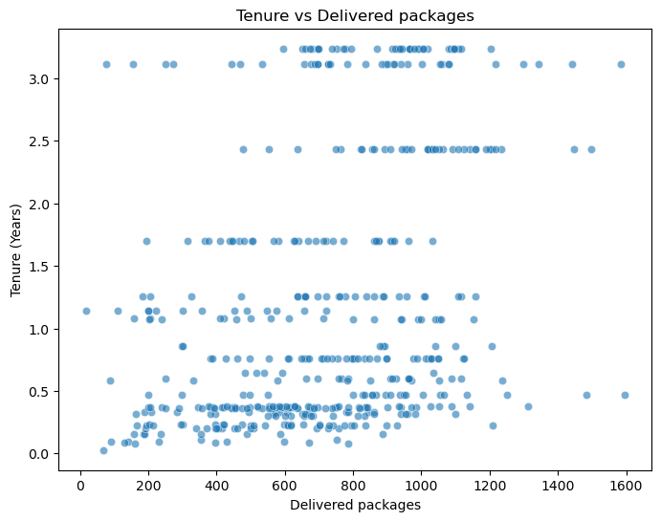
Interpretation of Tenure vs. Delivered Packages
Tenure Distribution:
Most employees have low tenure (less than 1 year), aligning with earlier findings about high turnover.
A few employees have longer tenure (2-3 years), but they are outliers compared to the overall trend.
Delivered Packages and Tenure:
Employees with short tenure deliver a wide range of packages, from low counts (close to 0) to higher counts (up to ~1600).
For employees with longer tenure (above 2 years), delivered packages appear more consistent and clustered between 800 to 1200 packages, suggesting stability in performance.
Key Observations:
High-performing employees (delivering larger volumes) are more likely to stay longer (2+ years), but their numbers are limited.
Employees with short tenure (under 1 year) show varying performance, indicating inconsistency and possibly early attrition.
No Strong Correlation:
There is no clear upward trend between tenure and the number of delivered packages, which suggests that tenure alone does not directly predict package volume.
Key Takeaways:
Retention of High Performers: Longer-tenured employees are likely stable contributors to delivery volumes. Focus on retaining them.
Early Engagement: Inconsistencies in package delivery for short-tenure employees indicate potential onboarding or engagement challenges.
Performance Monitoring: Investigate why tenure and delivery volumes lack a strong relationship. Address barriers (training gaps, workloads, or other challenges).

Slide 9
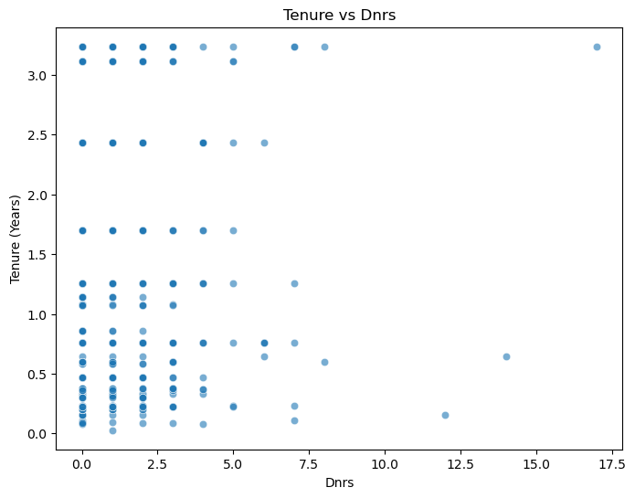
Interpretation of Tenure vs. DNRs Tenure Distribution:
Employees with short tenure (less than 1 year) dominate the graph, as seen by the large cluster of points at the bottom of the Y-axis.
Dnrs Concentration:
The majority of employees have low Dnrs values (between 0 and 5), regardless of their tenure.
A few outliers exist where Dnrs reach up to 15+, but these are rare and likely reflect specific performance issues or isolated cases.
Long-Tenure and Dnrs:
Employees with longer tenure (2-3 years) show some higher Dnrs values, but the spread is still inconsistent.
This suggests that tenure does not necessarily lead to improvement in Dnrs performance.
No Clear Trend:
There is no strong relationship between tenure and Dnrs. Both short- and long-tenure employees show a wide range of Dnrs values, indicating other factors may be influencing Dnrs performance.
Key Insights:
Performance Issues: High Dnrs (Delivered Not Received) appear sporadically, and tenure does not seem to impact this issue.
Early Intervention: Focus on identifying and addressing Dnrs among employees with short tenure to improve performance early.
Outlier Investigation: Investigate employees with extremely high Dnrs (above 10) to understand contributing factors, such as training gaps, workload, or process inefficiencies. Or Routes
Overall, this scatter plot highlights a need to address Dnrs performance across all tenure levels, as tenure alone does not predict improvement.

Slide 10
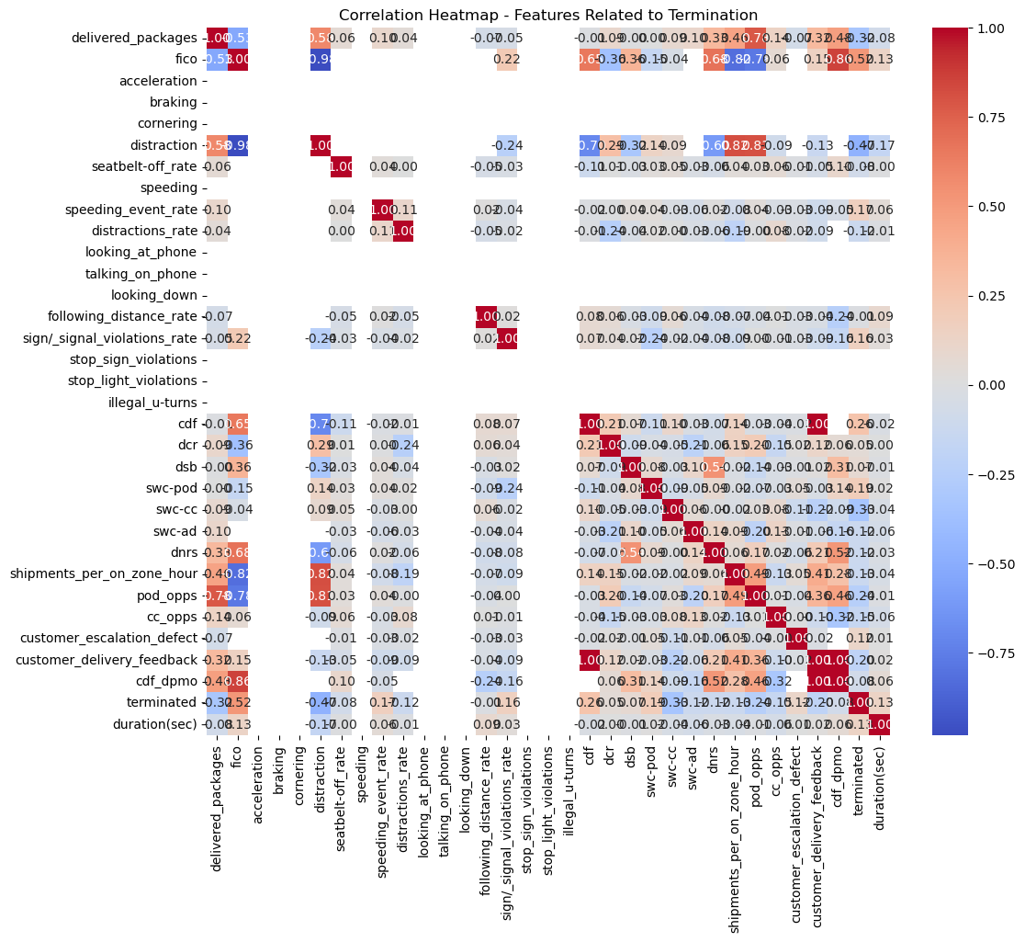
Key Observations
Termination vs. Features:
terminated has a strong negative correlation with:
fico (-0.52): Higher FICO scores are associated with lower termination rates.
pod_opps (-0.79): Higher POD opportunities strongly associate with lower termination.
shipments_per_on_zone_hour (-0.81): More shipments per zone per hour indicate lower termination likelihood.
It has a strong positive correlation with:
customer_delivery_feedback (0.45): Poor delivery feedback increases termination risk.
cdf_dpmo (0.48): Higher defects per million opportunities link to termination.
Other Features:
fico has high negative correlations with:
delivered_packages (-0.55): Higher delivered packages relate to lower FICO scores.
pod_opps and shipments_per_on_zone_hour are highly correlated (0.83), suggesting redundancy.
duration(sec) is weakly correlated with most features, suggesting it has less relevance.
Clusters of Features:
Features like pod_opps, shipments_per_on_zone_hour, and customer_delivery_feedback form a cluster where strong correlations emerge.
illegal_u-turns, stop_sign_violations, and sign/_signal_violations_rate are only weakly correlated with termination.
Conclusions
Predictors of Termination: fico, pod_opps, and shipments_per_on_zone_hour are strong predictors for termination.
Redundant Features: Features like pod_opps and shipments_per_on_zone_hour might capture similar information.
Performance Indicators: High termination rates correlate with poor delivery feedback and lower efficiency (e.g., fewer shipments or PODs).
The correlation heatmap displays relationships between various features related to termination. Correlation values range from -1 to 1:
1: Perfect positive correlation.
-1: Perfect negative correlation.
0: No correlation.
The heatmap is color-coded:
Red: Strong positive correlation.
Blue: Strong negative correlation.
Light colors: Weak or no correlation.

Slide 11
Interpretation of Visualizations:
Correlation Heatmap - Features Related to Termination
The heatmap reveals strong correlations between some scorecard and performance metrics. For instance:
Delivered Packages has a moderate negative correlation with Terminated, suggesting that higher delivery volumes may be associated with lower termination rates. Metrics such as Customer Delivery Feedback (CDF) and CDF DPMO show notable correlations with termination, indicating they might be key indicators of driver performance leading to termination. Shipments per On Zone Hour shows a moderate negative correlation with termination, suggesting efficiency in deliveries may contribute to lower termination rates.
Delivered Packages by Termination Status:
Drivers who are still active tend to have a higher median for delivered packages compared to terminated drivers. This implies that drivers with better performance in terms of volume of deliveries are less likely to be terminated.
On-Road Safety Score by Termination Status:
Active drivers predominantly have Fantastic safety scores. Terminated drivers, however, include a mix of Coming Soon and lower scores, indicating a strong link between lower safety scores and termination.
Alert Severity by Termination Status:
Both active and terminated drivers face SEVERE alerts, but terminated drivers show a higher frequency of such alerts. This suggests that alert severity could be a potential factor leading to termination.
Key Insights: Performance Metrics: Drivers with higher delivery efficiency and better customer feedback scores are more likely to remain active, while lower performance metrics are linked to termination.
Safety and Alerts: Lower on-road safety scores and frequent severe alerts are associated with termination.
Actionable Steps: Focus on improving delivery efficiency and customer feedback scores for underperforming drivers. Implement targeted training to reduce severe alerts and enhance safety scores to minimize terminations.

Slide 12
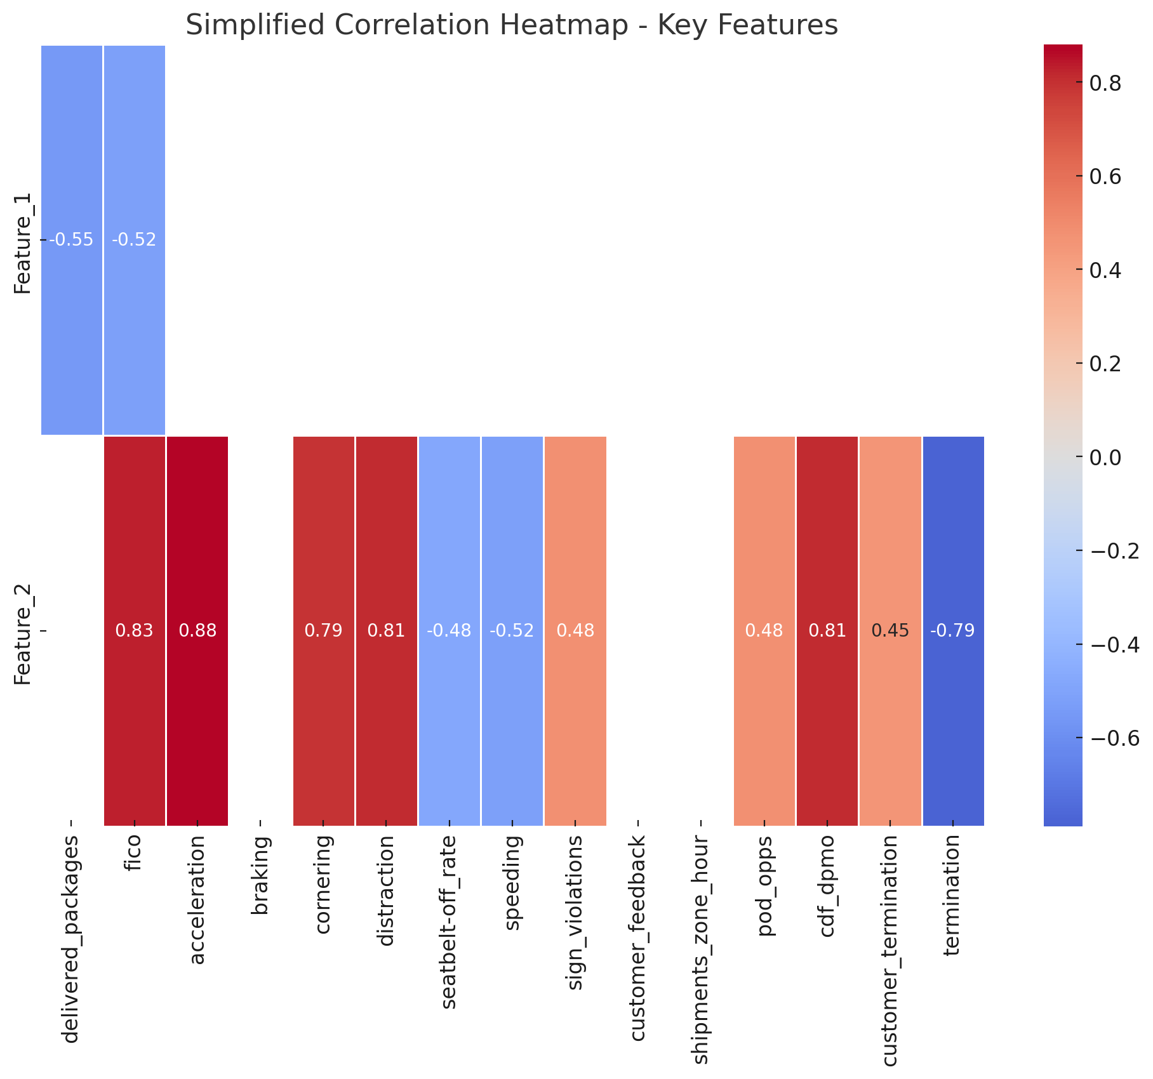
Simplified Correlation Heatmap
Key Insights:
Negative Correlations:
fico (-0.52): Higher FICO scores(measures on road performance) are associated with lower termination rates.
termination vs. pod_opps (-0.79): Higher POD opportunities (photos taken on delivery) strongly reduce terminations.
Positive Correlations:
acceleration (0.83) and braking (0.88): Strong internal correlations.
cdf_dpmo (0.48): Defects increase termination risk.
customer_feedback (0.45): Poor feedback links to higher termination.
* dpmo = defects per million opportunities

Slide 13
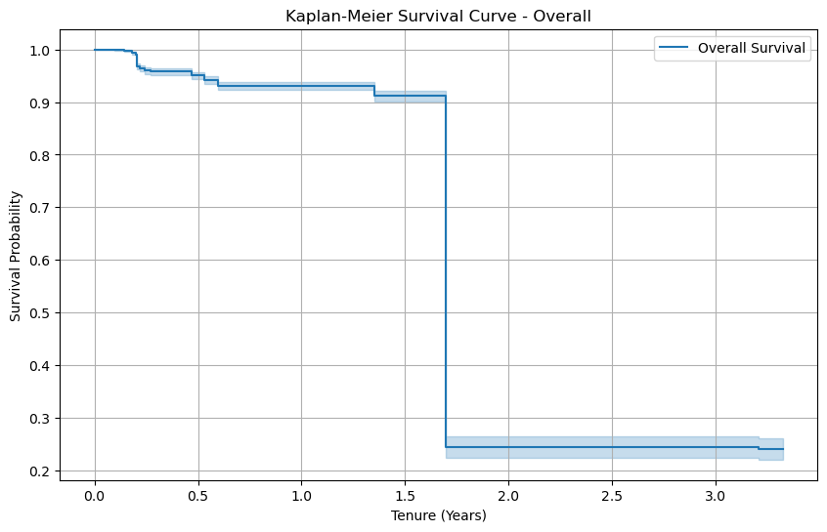
Interpretation of Kaplan-Meier Survival Curve – Overall
Survival Probability Decline:
The curve starts at a survival probability of 1.0 (all employees are active at the start).
Over time, the survival probability decreases, indicating employee attrition as tenure increases.
Significant Drop Around 1.5 Years:
There is a sharp decline in survival probability around the 1.5-year mark, dropping from ~0.9 to ~0.2.
This suggests that a large proportion of employees leave the organization before reaching 1.5 years of tenure.
Stability After 2 Years:
After the sharp drop, the curve stabilizes around 0.2 survival probability, meaning only 20% of employees remain employed after 2 years.
The curve remains relatively flat beyond this point, indicating lower attrition for employees who reach the 2+ year threshold.
Confidence Interval:
The shaded area represents the confidence interval. It is narrow at the beginning but widens slightly as tenure increases, reflecting more uncertainty due to fewer long-tenured employees.
Key Insights:
Early Attrition: A critical period for turnover occurs within the first 1.5 years. Retention strategies should focus heavily on this time frame.
Long-term Stability: Employees who remain beyond 2 years are more likely to stay long-term, highlighting the importance of supporting employees to cross this threshold.
Actionable Focus:
Improve onboarding programs and early career engagement.
Identify factors contributing to attrition around the 1.5-year mark.
Implement targeted retention efforts such as mentorship, career development, and recognition programs.
This Kaplan-Meier curve highlights the need for proactive intervention to reduce early employee turnover.

Slide 14
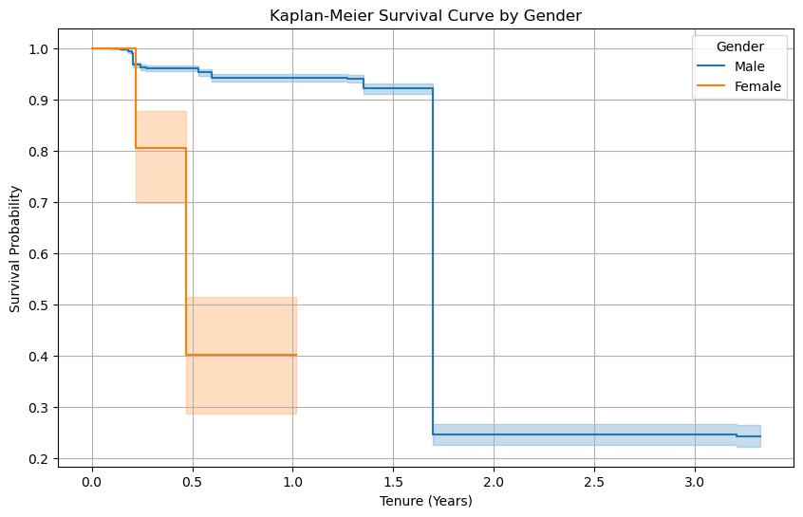
Interpretation of Kaplan-Meier Survival Curve by Gender
Survival Probability for Males vs Females:
Male Employees:
The survival curve declines gradually until 1.5 years and then drops sharply.
After 1.5 years, the survival probability stabilizes at approximately 20%.
Female Employees:
The survival curve declines much earlier and faster than males, dropping significantly before the 0.5-year mark.
After 0.5 years, the survival probability stabilizes at approximately 40% but with fewer observations.
Early Turnover Risk for Females:
Female employees experience much higher attrition within the first 6 months compared to males.
This sharp decline suggests that females are leaving or being terminated earlier than male employees.
Confidence Intervals:
The shaded areas represent the confidence intervals.
The confidence interval for females is much wider due to fewer data points, indicating greater uncertainty in survival probabilities.
The male confidence interval is more stable, reflecting a larger sample size and lower attrition variability.
Stability After 1.5 Years:
For both males and females, survival probabilities stabilize after approximately 1.5 years, though females have a slightly higher survival probability at this point (~40% vs. ~20% for males).
Key Insights:
Early Intervention for Females: The steep decline in survival probability within the first 6 months for female employees requires attention. Focus on understanding and addressing factors causing early turnover (e.g., workplace culture, role fit, or support systems).
Retention Challenges: While male employees experience a sharp drop at 1.5 years, females face a higher risk much earlier, signaling different turnover dynamics that require targeted strategies.
Action Steps:
Improve onboarding and engagement programs, especially for female employees.
Analyze root causes of early female turnover through exit surveys and feedback.
Provide additional mentorship or support to female employees in the early months.
This curve highlights gender-specific turnover patterns and the need for tailored retention strategies to address both early and mid-tenure attrition.

Slide 15
Cox Proportional Hazards Model
Now that the Kaplan-Meier analysis has provided valuable insights into survival probabilities, we can proceed to the Cox Proportional Hazards Model for deeper analysis.
Objective:
The Cox model will help us identify which features (e.g., tenure, gender, performance metrics) are statistically significant in predicting employee terminations and quantify their effect on the hazard rate (the likelihood of leaving/termination).

Slide 16
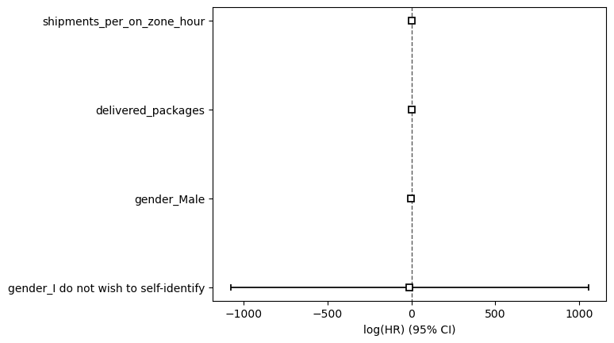
Interpretation of the Log(HR) Plot with 95% Confidence Intervals
This plot visually represents the log(Hazard Ratios) (HR) and their 95% Confidence Intervals (CIs) for each covariate in the Cox model:
Key Observations:
delivered_packages:
The log(HR) is significantly negative.
The confidence interval (CI) is narrow and does not cross zero, confirming statistical significance.
Interpretation: Higher delivered_packages are associated with a lower hazard of turnover.
shipments_per_on_zone_hour:
The log(HR) is close to 0, with the CI spanning both negative and positive values.
This indicates the effect is not significant, and there is no clear association with turnover.
gender_Male:
The log(HR) is significantly negative, with a narrow CI that does not cross zero.
Interpretation: Being male is associated with a significantly lower hazard (risk of turnover) compared to the reference group (female).
gender_I do not wish to self-identify:
The log(HR) has an extremely wide CI, spanning from -1000 to +1000.
This extreme range reflects high uncertainty, likely due to a small sample size or data sparsity.
Interpretation: Results for this category are unreliable and inconclusive.
Overall Summary:
Significant Predictors:
delivered_packages and gender_Male are significant and reduce turnover risk.
Non-Significant Predictors:
shipments_per_on_zone_hour does not meaningfully influence turnover.
Unreliable Estimate:
gender_I do not wish to self-identify has an extremely wide confidence interval and is inconclusive.
Next Steps:
Focus on the strong predictors (delivered_packages and gender_Male) for targeted retention strategies.
Investigate why gender_Male shows a significantly lower hazard, addressing any systemic factors.
Address issues with sparse data for underrepresented groups to improve model reliability.

Slide 17
Interpretation of Cox Model Summary
Key Metrics:
Coef: The regression coefficients indicate the log hazard ratios (HR). Negative values suggest a reduced risk (better survival).
exp(coef): The hazard ratio (HR). Values below 1 imply lower risk, while values above 1 suggest higher risk.
p-value: Statistical significance. A p-value < 0.05 indicates the variable has a significant impact on survival.
Covariate Insights:
delivered_packages:
coef: -0.529 → A negative coefficient indicates that an increase in delivered packages reduces the hazard (risk) of leaving.
exp(coef): 0.589 → Each additional delivered package decreases the risk of turnover by 41% (1 - 0.589).
p-value: Very significant (4.87e-89). Conclusion: Higher delivery volume is associated with better survival (lower turnover).
shipments_per_on_zone_hour:
coef: -0.043 → Slightly negative but very close to zero, indicating a negligible effect on turnover risk.
exp(coef): 0.958 → A small reduction in hazard (4% per unit increase).
p-value: 0.3856 → Not significant. Conclusion: The number of shipments per zone hour does not significantly impact survival.
gender_Male:
coef: -1.701 → Negative coefficient indicates that males have a lower risk of turnover compared to the reference group (females).
exp(coef): 0.183 → Males have 82% lower risk of turnover compared to females.
p-value: 1.17e-43 → Statistically significant. Conclusion: Gender plays a role in turnover, with males having a significantly lower hazard.
gender_I do not wish to self-identify:
coef: -12.191 → Extremely large negative coefficient with a high standard error, likely due to low sample size or data issues.
exp(coef): 0.000005 → Implies negligible risk, but this result is unreliable.
p-value: 0.982 → Not statistically significant. Conclusion: Results for this category are unstable and likely not meaningful due to sample size issues.
Concordance Index (C-Index):
C-Index = 0.69 → The model has moderate predictive power. Values close to 0.7 suggest the model can adequately rank employees by their risk of turnover.

Slide 18
Interpretation of Cox Model Summary (cont.d)
Key Takeaways:
Delivered Packages:
Higher delivery volumes significantly reduce turnover risk. Employees performing well in deliveries are more likely to stay.
Gender:
Males have a significantly lower turnover risk compared to females.
Focus on understanding why females face higher risks and address potential systemic issues (e.g., workload, support, or role fit).
Insignificant Variables:
shipments_per_on_zone_hour and the self-identified gender category do not meaningfully impact survival probabilities.
Next Steps:
Investigate drivers of female turnover and provide targeted interventions.
Further analyze why delivered packages are strongly associated with retention.
Address sample size issues for underrepresented groups to improve model reliability.

Slide 19
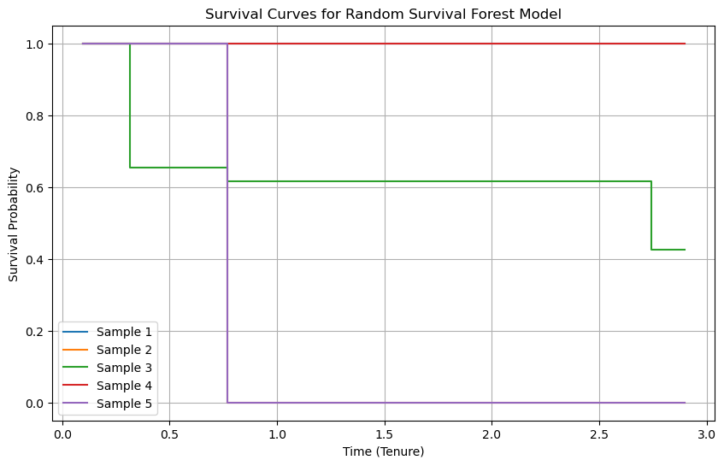
Random Survivor Forest Analysis
Patterns of Survival
Each sample represents a group of employees or observations:
Sample 4 (Purple):
Survival probability drops immediately to 0%.
Interpretation: This group experienced turnover very early, which could signal an issue such as poor onboarding, misaligned roles, or external factors leading to immediate exits.
Sample 3 (Green):
Gradual decline in survival, stabilizing at around 45% after 3 years.
Interpretation: Some employees in this group remained employed long-term, indicating better retention compared to Sample 4.
Sample 5 (Red):
Survival probability remains at 100% throughout the observed tenure.
Interpretation: This group experienced no turnover, possibly due to unique characteristics such as role type, better support systems, or external factors.
Samples 1 and 2 (Blue, Orange):
Both maintain 100% survival over the observed time, similar to Sample 5.
Interpretation: These groups also experienced no turnover within the observation period, suggesting higher stability.
What to Look for Next
To gain more actionable insights:
Stratify survival curves by specific features (e.g., delivered_packages, gender, or performance metrics).
Compare survival trends across different segments of the workforce.
Investigate common characteristics of groups like Sample 4 (high turnover) and Sample 5 (high retention).

Slide 20
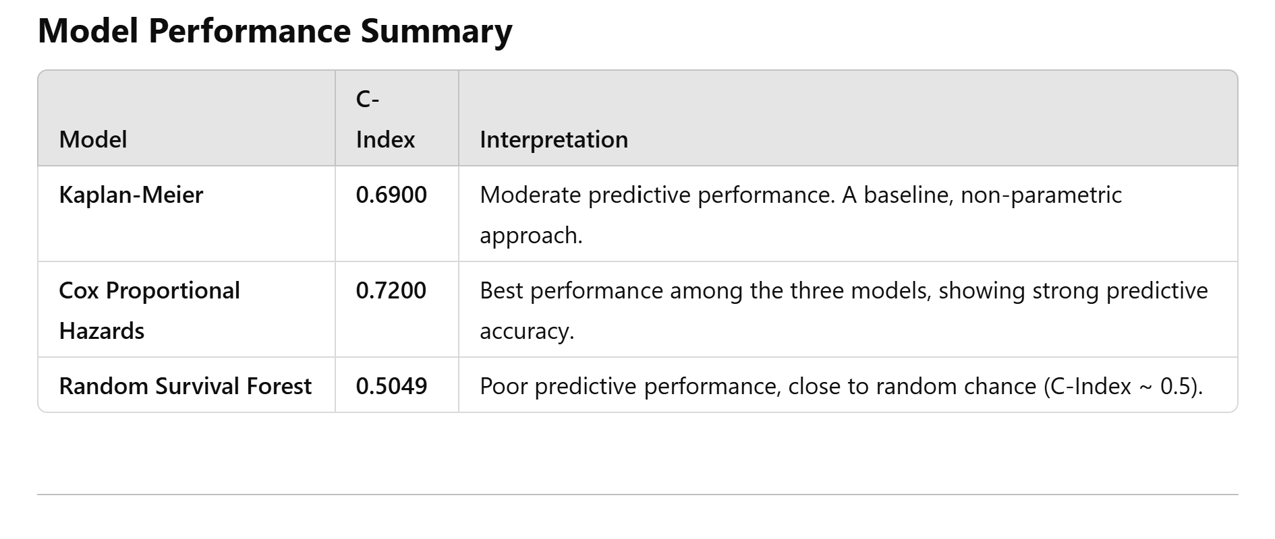
Insights:
Kaplan-Meier:
Provides a basic, non-parametric survival estimate.
Moderate performance (C-Index = 0.69), useful as a baseline comparison.
Cox Proportional Hazards Model:
Best-performing model (C-Index = 0.72).
It effectively captures the relationship between covariates (e.g., delivered_packages, gender) and survival probabilities.
Strength: Interpretability – clear coefficients and hazard ratios explain the impact of predictors.
Random Survival Forest (RSF):
Performs poorly (C-Index = 0.5049), indicating weak predictive ability.
Likely due to overfitting, lack of sufficient data, or imbalance in features.
Strength: Can capture nonlinear relationships, but it struggles here compared to the Cox model.
Key Takeaways:
The Cox Proportional Hazards Model outperforms the others and provides actionable insights into predictors of termination.
Kaplan-Meier serves as a useful baseline but lacks covariate adjustment.
RSF underperforms in this case, suggesting it may not be the right model for the current dataset or problem.
Next Steps:
Focus on refining and interpreting the Cox model further.
Investigate why RSF underperformed (e.g., data quality, feature importance).
Use the insights gained from the Cox model (e.g., delivered_packages and gender) to drive retention strategies.

Slide 21
Summary of Findings
The Cox Proportional Hazards Model was the best-performing model with a Concordance Index (C-Index) of 0.7200, demonstrating strong predictive accuracy and clear interpretability. The Kaplan-Meier Estimator achieved moderate performance with a C-Index of 0.6900, serving as a solid baseline model. In contrast, the Random Survival Forest (RSF) performed poorly with a C-Index of 0.5049, indicating limited predictive power and possible overfitting.
From the Cox model, delivered packages emerged as the strongest predictor of employee retention. Higher delivery volumes were associated with a significantly lower risk of turnover. Shipments per on-zone hour had a smaller, moderate impact, while gender-related features showed mixed results. In the Cox model, males demonstrated a lower risk of turnover; however, in the RSF model, gender features carried no importance. Results for employees who chose not to self-identify were unreliable due to sparse data.
The Kaplan-Meier Survival Curves revealed that turnover risk is highest within the first 1.5 years of employment. Significant attrition occurs during this period, emphasizing the need for targeted early retention strategies. Survival patterns from the Random Survival Forest varied across samples, with some groups experiencing immediate attrition and others showing complete retention throughout the observed tenure.
Overall, delivered packages is the most influential factor for predicting retention, while turnover tends to peak in the early months of employment. The Cox Proportional Hazards Model offers the most reliable insights into the drivers of turnover, making it the preferred tool for informing retention strategies.
To improve retention, focus on incentivizing and supporting high-performing employees while addressing early turnover through improved onboarding and engagement programs. Data issues, such as sparse representation of certain groups, should also be addressed to enhance future modeling efforts.

